Slide 1
What is not an argument?

Slide 2
Introduction
We encounter arguments everywhere in daily life—at school, at work, in magazine ads, in newspaper editorials, in political discussions, in television documentaries, and on radio talk shows.
Of course, people don’t use language only to offer arguments: they also use it to tell jokes, sing songs, recite poetry, express feelings, report events, ask questions, offer explanations, say prayers, give orders, and exchange wedding vows.
How, then, can we distinguish arguments from nonarguments?

Slide 3
The basic test is quite simple. Something counts as an argument when
it is a group of two or more statements, and
one of those statements (the conclusion) is claimed or intended to be supported by the others (the premises).
By applying this simple test, we can usually tell whether a given passage is or is not an argument.
Look at these five types of non-argumentative discourse that are sometimes confused with arguments:

Slide 4
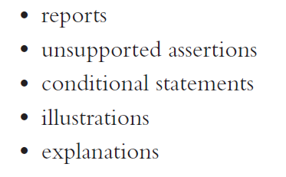
5 types of non-argumentative discourse

Slide 5
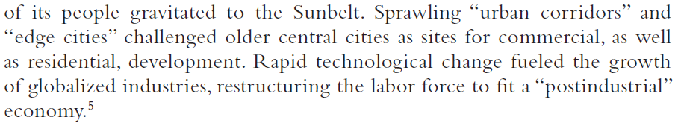
Reports
The purpose of a report is simply to convey information about a subject. Here is an example of a report:

Slide 6
In this passage, the authors are simply reporting a series of events; their aim is to narrate and inform, not to offer reasons why one statement should be accepted on the basis of others.
Caution is needed, however, with reports about arguments. Here is an example of such a passage:

Slide 7
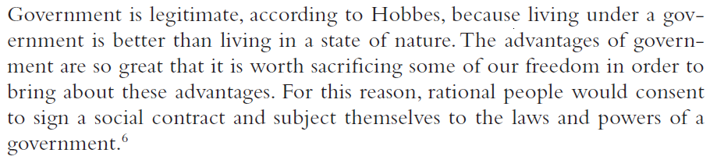
This is not an argument, because the author is merely reporting another person’s argument, not endorsing it or putting it forward as his own.

Slide 8
Unsupported Assertions
Unsupported assertions are statements about what a speaker or writer happens to believe.
Such statements can be true or false, rational or irrational, but they are parts of arguments only if the speaker or writer claims that they follow from, or support, other claims.
Here is an example of a series of unsupported assertions:

Slide 9
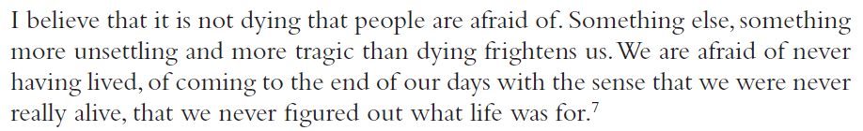
Because there is no claim that any of these statements follow from, or imply, any other statements, this is not an argument.

Slide 10
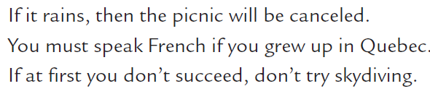
Conditional Statements
A conditional statement is an if-then statement. Here are several examples:
Conditional statements are made up of two basic parts.
The first part, the statement(s) following the word if, is called the antecedent. The second part, the statement(s) following the word then, is called the consequent.

Slide 11
Conditional statements are not arguments, because there is no claim that any statement follows from any part of a conditional statement.
Thus, if I say, “If it rains, the picnic will be cancelled,” I’m not asserting either that it will rain or that the picnic will be cancelled.
I’m only asserting that if the first statement is true, the second statement will also be true.
Because there is no claim that any statement follows from, or supports, this conditional statement, no argument has been given.

Slide 12
Although conditional statements are not arguments, some conditional statements do involve a process of reasoning.
Thus, if I say, for example,
it may appear that I have reasoned to a conclusion, and thus offered an argument.
In fact, however, no argument has been given. All I have asserted is that if the first two statements are true, then the third statement must also be true.
I have not claimed that any of these statements are true. Thus, I have not put forward any premises or reasoned to any conclusion.

Slide 13
In fact, I have asserted only a single claim: that one statement is true on the condition that two other statements are true.
Certainly, this claim was arrived at by a process of reasoning, but that does not mean that it is an argument.
As we have seen, no single claim by itself is ever an argument.

Slide 14
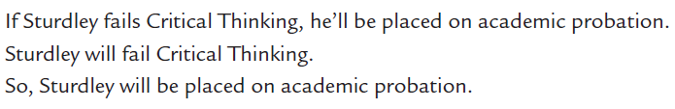
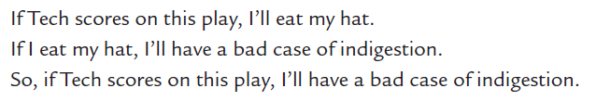
Chain arguments
Conditional statements, accordingly, are not arguments. They can, however, be parts of arguments. For example:
In fact, arguments can be composed entirely of conditional statements:
Such arguments are sometimes called chain arguments because the antecedent (the if part) of the first statement is linked to the consequent (the then part) of the last statement by a chain of intervening conditional statements.

